Slide 1

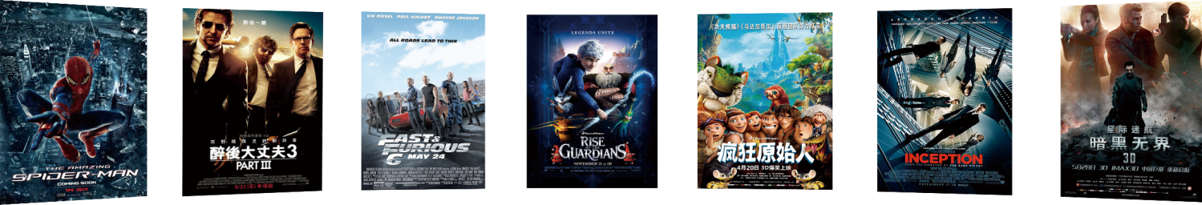
Movie Night
Where choosing is child’s play
Group 6: Andrew, Enessa, Minh, Pedro, Rachel
Notes:
Enessa– Hands up if your biggest bug bear when deciding watch movie to watch is… deciding what movie to watch?
With the multitude of streaming services available we seem to all suffer from paralysis analysis.
Well the team and I are here to ensure you suffer no more.
Whether you are couple clashing over action vs comedy. Or a family fighting over frozen 1 or 2, our company has developed the ultimate app. Movie Night. Where choosing is child’s play.

Slide 2
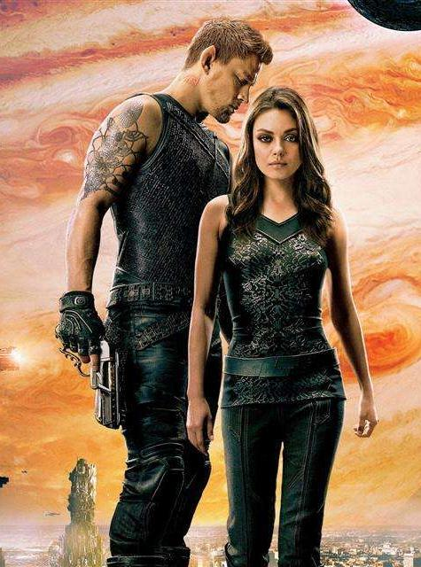
01
Project goals
02
Data storage and tools
03
App design
04
Usage
05
Limitations & possibilities
Notes:
Tonight Our team have the pleasure to guide you through the magical adventure of developing an app protype, that addresses a very common and modern problem.
Enessa – project goals and purpose of the app
Pedro – Data storage and tools (API, Python, etc)
Minh – App design and organisation
Andrew – usage case – three levels of opportunity
Rachel – limitations and possibilities for future set up

Slide 3
CONTENTS
1
PROJECT GOAL
Notes:
Enessa - first we started with a clear and definitive goal.

Slide 4

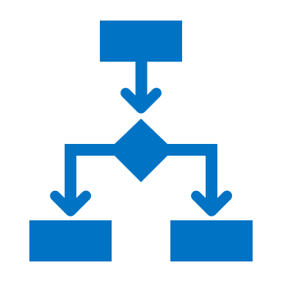

Goal & purpose
Target audiences
An app that makes it easy for users to select a film
Based on their needs or preference.
Useful in multiple contexts
Single user - app
Steaming services - information
Production houses
Collected
Stored
Analysed
Processed
Visualized
Data Cycle
Notes:
The goal of the MOVIE NIGHT project was to develop an application that makes it easy for the end user to make a movie choice based on their preferences.
However, we made sure through analysis and visualization that the application has multiple uses. We saw three potential uses or clients for this application.
The first being individuals such as singles, couples and families. However, we can see that streaming services providing the next generation of movies need to know which films people are wanting to watch and therefore which movies should they spend money on creating? Finally, for production companies which movies are worth producing and funding?
I will now hand over to Pedro to discuss the first steps in the data storage process.

Slide 5
CONTENTS
2
DATA STORAGE
Notes:
Pedro- our next step was in the storage

Slide 6
Behind the Scenes
Back End
Front End
Flask, SQLAlchemy & SQLite
Python
Java Script (JS)
HTML
CSS
The Back end of the Movie Night App revolves around Python Code.
All Data has been converted to a local API using Flask & SQLAlchemy to create an engine.
From a front-end perspective, all the graphs have been created with Java Script.
HTML was used to format the App, Calling on the JS to display the visuals in a client facing format.
In addition to HTML, CSS was used to further enhance the aesthetics of the app.
Notes:
Pedro to discuss the tools used and how we stored the data – discuss the cleaning process?

Slide 7
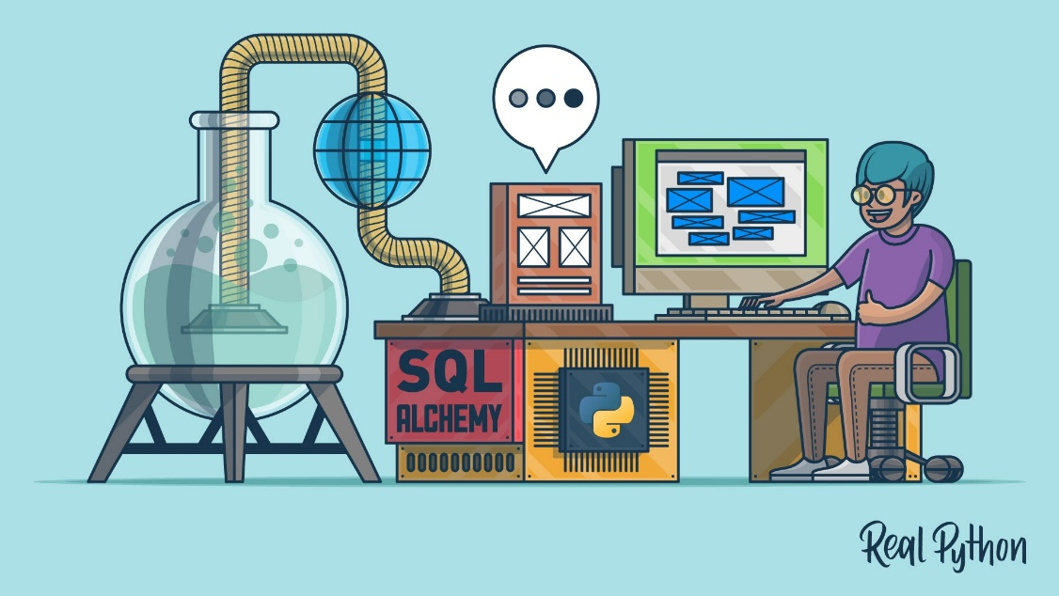
Data Handling:
3
Data is stored as a local CSV.
Python and modules (SQLAlchemy, Flask & SQLite) “run an engine” calling data in the form of a local API
Data is “called” into the app providing the information displayed in the visualisations
1
2
Notes:
Pedro to discuss the tools used and how we stored the data – discuss the cleaning process?
🡪 Brief comment about minor adjustments made to the CSV File
hand over to Minh to discuss the app design

Slide 8
CONTENTS
3
APP DESIGN

Slide 9
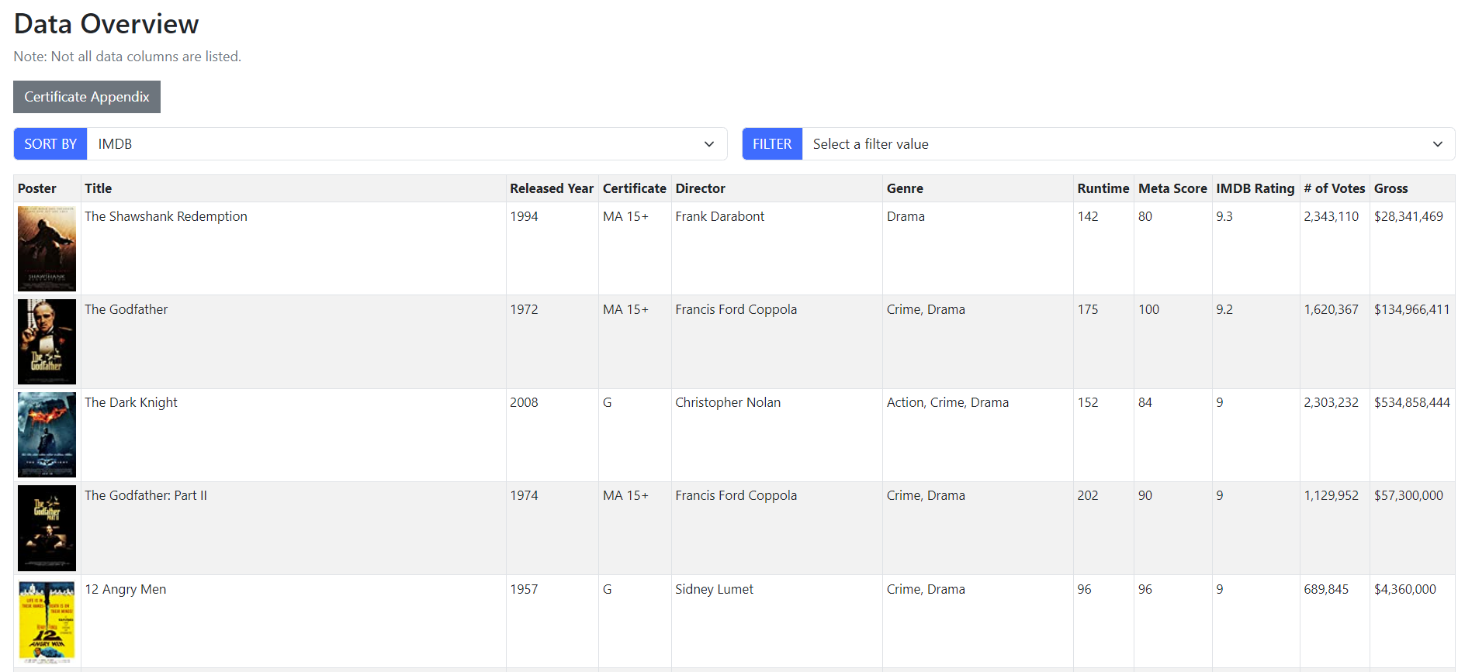
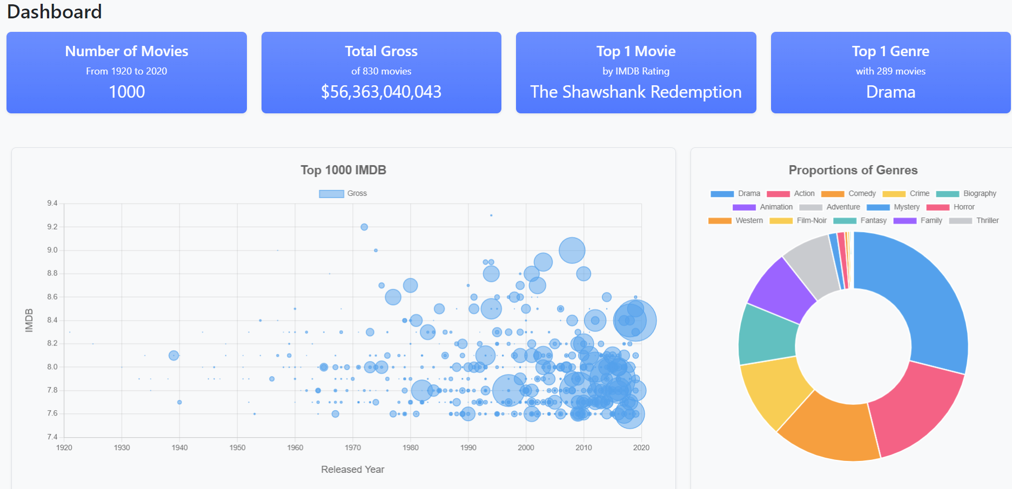
Purpose of the app design
Provide overview of the dataset
Provide detailed insights and analysis of the movie industry
Notes:
Purpose of the app design:
Provide an overview of the dataset by showing all the information of each movie, as well as some general insights by using Sort and Filter function.
Provide detailed insights and analysis of the movie industry to the audience by using interactive charts and tables.

Slide 10
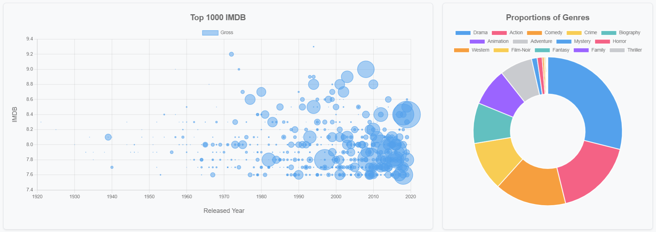
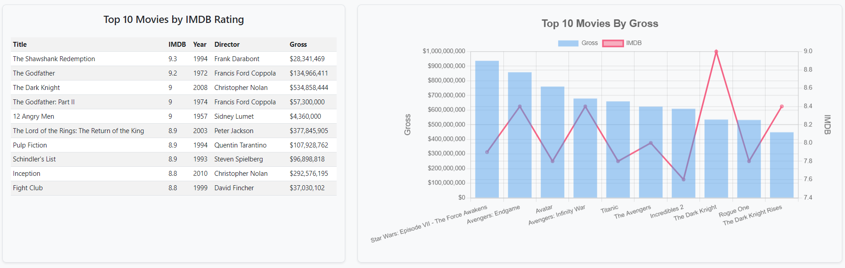
The choices of charts
The bubble chart presents multi - dimensional data and demonstrate hidden trend.
The dual axis chart with additional table: observe two variables with significantly different scales inside the same graph.
The doughnut chart shows proportion of each key component.
Notes:
We used different type of charts in our dashboard for different purposes:
The bubble chart is a perfect chart to present multi-dimensional data and show some hidden patterns and trends in our data.
The mixed bar and line charts in addition with simple tables have been deployed to show the top 10 of a selected attribute which is perfect to answer many business questions for example: which movie genre a company should invest in, which director is the most successful, etc.
The doughnut chart is simply the most appropriate one to show the proportions of each key component so that we answer the question which genre having the most film produced.
Hand over to Andrew to discuss usage

Slide 11
CONTENTS
4
USAGE CASES

Slide 12
What is the top grossing movie between 1920 and 2020?
Which movie director has the highest box office takings?
A
Avatar (2009)
A
Peter Jackson
Star Wars Episode VII - The Force Awakens (2015)
Steven Spielberg
B
B
C
Avengers - End Game (2019)
C
James Cameron

Slide 13
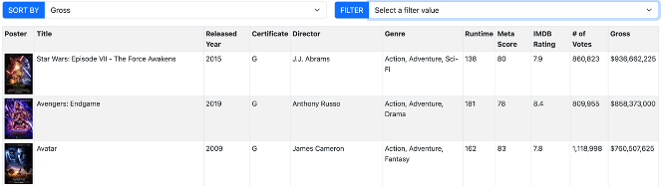
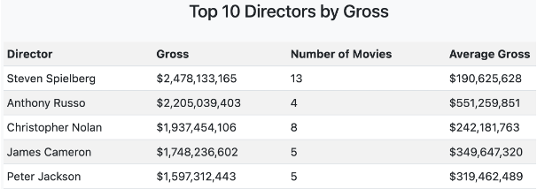
What is the top grossing movie between 1920 and 2020?
Which movie director has the highest box office takings?
A
Avatar (2009)
A
Peter Jackson
Star Wars Episode VII - The Force Awakens (2015)
B
B
Steven Spielberg
C
Avengers - End Game (2019)
C
James Cameron

Slide 14
CONTENTS
5
LIMITATIONS & POSSABILITY

Slide 15
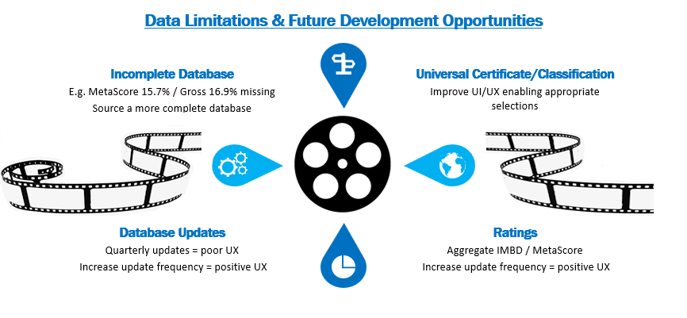
Notes:
Data Limitations
•Incomplete Database – MetaScore 15.7% / Gross 16.9% missing
•Database Updates – quarterly updates = poor UX
•IMDB Ratings – Impact of low IMDB vote counts
•Data Integrity – IMBd Launched 1990
Future Development Opportunities
•Database Updates - Increase update frequency
•Universal Certificate/Classification - Improve UI/UX enabling appropriate selections
•Ratings - Aggregate IMBD / MetaScore
•MetaScore - boost UI

Slide 16
Data Limitations & Future Development Opportunities
•Incomplete Database – MetaScore 15.7% / Gross 16.9% missing
•Database Updates – quarterly updates = poor UX
•IMDB Ratings – Impact of low IMDB vote counts
•Data Integrity – IMBd Launched 1990
Future Development Opportunities
•Database Updates - Increase update frequency
•Universal Certificate/Classification - Improve UI/UX enabling appropriate selections
•Ratings - Aggregate IMBD / MetaScore
•MetaScore - boost UI
Notes:
Rachel to discuss the limitations of the data set and the possibilities for turning into a bigger and better application
Data Limitations
Incomplete Database:
·Certificate – Missing 10.2% of data (102 records)
·MetaScore – Missing 15.7% of data (157 records)
·Gross – Missing 16.9% of data (169 records)
·Genre 2 – Missing 10.5% of data (105 records)
·Genre 3 – Missing 35.4% of data (354 records)
Database Updates:
·Current database source is updated quarterly - frequency may not satisfy consumer needs
IMDB Ratings:
·Low IMDB vote count – Consequences of a lower IMDB count, under a hundred, increases the possibility of the weighted rating to experience dramatic fluctuations.
·Popular Opinion – Remember that ratings can change over time. A movie may gain popularity over time or rapidly
Data Integrity:
Future Development Opportunities
Database Updates:
·Increase update frequency – maintain data integrity and relevance via IMDb’s multiple daily updates
Universal Certificate/Classification:
·Certificate/Classification country origin provided in database
·Develop a Universal Certificate/Classification system to align individual country/regions using the same Certificate/Classification for significantly different definitions!
·Certificate – Country Definition “A” Canada
Ratings:
·Aggregate the IMBD (user) and MetaScore (industry) to provide an additional rating option
MetaScore:
·Use MetaScore data to further develop the user dashboard, including the general meanings and colour system from the IMBd score break downs in UI

Slide 17
THANK YOU !
Notes:
Thanks and good bye

